Slide 1
Xamarin 101
What you need to know to get started With Xamarin.Forms today!

Slide 2




About Me
Chester (Chet) Hartin
Technical Architect @ Concurrency
Focus: C#, APIs, Messaging services, Xamarin.
GitHub: https://github.com/chesterhartin
Twitter: @ChetHartin

Slide 3


Slide 4
Syllabus
Intro To Xamarin
Basic building blocks of Xamarin.Forms
XAML Introduction
Databinding
View Customization
What to do next?

Slide 5
Intro To Xamarin
Why Xamarin when we have Java, Objective-C, Swift?
This leads to Write Everything Twice (WET) Development
Xamarin allows us to write for the iOS (8 and up), Android (API 15 / 4.0.3 and up), WFP, MacOS, Smart watches (iOS/Android), Samsung Smart devices

Slide 6


When should I use it?
Why Xamarin when we have Flutter, PhoneGap, Corona, React Native...
All of these are great tools!
But…
Your team knows C#/.Net
You need multiple-platform apps
You want a native app performance and/or look & feel

Slide 7



1000 Feet Above

Slide 8
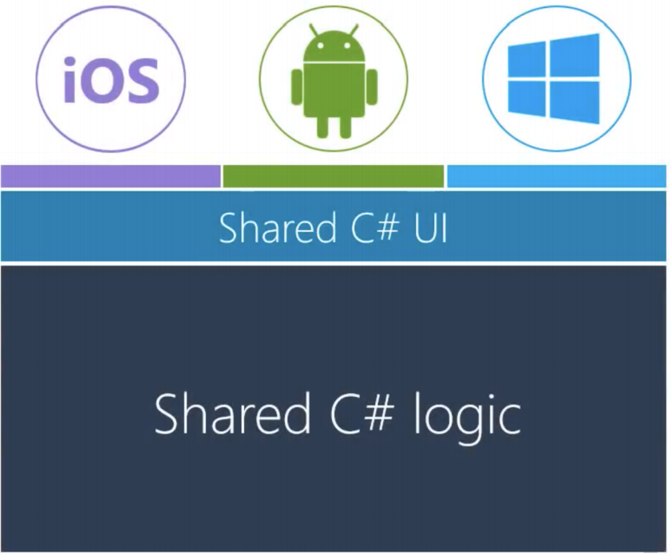
Xamarin.Forms
Xamarin.Forms share a UI definition*

Slide 9
History Recap
2011
Founded in 2011 as MonoTouch/Mono For Android
2013
Renamed & integration into Visual Studio / Launch Of Xamarin Studio
2016
Purchased by Microsoft
Full time development / support
Free & 100% open-sourced

Slide 10
What Do I need?
PC
Visual Studio 2017 / 2019
Mac
Visual Studio for Mac
Note: iOS development REQUIRES a Mac to build/test

Slide 11
Basic Building Blocks
Pages
Layouts
Views
Cells
Flexible Layout
Standard Controls
Navigation
Custom Controls
Data Binding
XAML
Styles + Triggers
Maps

Slide 12
Pages – Building Block 1

Slide 13
Layouts – Building Block 2

Slide 14
Views – Building Block 3
Button
Label
Entry
Switch
Activity Indicator

Slide 15





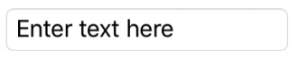




Views – Building Block 3 (cont)
Views | Android | iOS
Button
Label
Entry
Switch
Activity Indicator

Slide 16
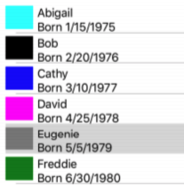
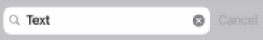
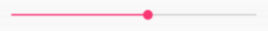
Views – Building Block 3 (cont)
List View
Table View
Image
Slider
Date Picker
Progress bar
Editor
Map
Web View
Open GL View
Frame
… And more!

Slide 17
Cells – Building Block 4
A View Cell (Cell) is a view optimized for data templates
Can use layouts
Great for a reusable template in a List.

Slide 18
XAML Introduction
Code time!
Anatomy of a Xamarin.Forms App
Content Page
Views
Styles
Layouts
Stack
Grid
Absolute

Slide 19


Slide 20
Databinding
Flexible Layout
Standard Controls
Navigation
Custom Controls
Data Binding
XAML
Styles + Triggers
Maps
How do we show information to the user?
How do we get user input?
Model-View-ViewModel (MVVM) Basics
View: knows how to display
ViewModel: knows what data to display
Model: the nouns of the system

Slide 21
Databinding (cont.)
Data
Data
View
XF Content Page
ViewModel
Class
Model
Class
Events
View: knows how to display data
ViewModel: knows what data to display
Model: the nouns of the system. Data Objects

Slide 22
Databinding (cont.)
Code Time!
Bindable Properties
Binding a Context
Converters

Slide 23


Slide 24

View Customization
What if Xamarin.Forms doesn’t behave the way I want it to?
Platform Specific Changes
Effects
Behaviors
Custom Renderers

Slide 25
View Customization (cont.)
Platform-Specifics
Use functionality that’s only available on a specific platform
iOS | Android
VisualElement.BlurEffect | VisualElement.Elevation
VisualElement.IsShadowEnabled | Button.UseDefaultPadding
Entry.AdjustsFontSizeToFitWidth | Button.UseDefaultShadow
Entry.CursorColor | Entry.ImeOptions (set action)
ListView.SeparatorStyle | ListView.IsFastScrollEnabled
NavigationPage.HideNavigationBarSeparator | NavigationPage.BarHeight

Slide 26
View Customization (cont)
Effects
AKA “Custom Renderers Lite”
Allow the native controls on each platform to be customized
Typically used for small styling changes
Benefits:
Simplify the customization of a control
Are reusable
Can be passed as parameters for increased reuse

Slide 27
View Customization (cont.)
Behaviors
Attach additional functionality to any Xamarin.Forms View
Examples
Allow n-characters in an entry
Only allow integers to be entered into an entry

Slide 28
View Customization (cont.)
Custom Renderers
Lets developers override the out-of-the-box renderers to customize the appearance/behavior of Xamarin.Forms on each platform
Think “can I do this with an effect?” first
Extend a Xamarin.Forms View
Required when there’s a need to override methods of a platform-specific control.

Slide 29

View Customization (cont.)
Code Time!
Platform-specific
Effects
Behaviors
Custom Renderers

Slide 30
What to do next?
Try out these device features:
Accelerometer, Barometer, Battery, Compass, Connectivity State, etc
Use plugins
NuGet packages implement and provide a lot of features!
Xamarin.Essentials - a must for an interactive app
Microsoft Learn (or Xamarin University until June 2019)
https://docs.microsoft.com/en-us/learn/browse/?roles=developer&term=xamarin
I recommend all the Xamarin.Forms courses

Slide 31
References
Documentation
All available online:
https://docs.microsoft.com/en-us/xamarin/
Slack
Get involved
https://xamarinchat.herokuapp.com/
Learn the hot MVVM frameworks
Prism https://prismlibrary.github.io/
ReactiveUI https://reactiveui.net/
MVVMCross https://www.mvvmcross.com/

Slide 32
Resources
Installing Xamarin: https://docs.microsoft.com/en-us/xamarin/get-started/installation/?pivots=windows
Build your first app with Xamarin.Forms: https://www.youtube.com/watch?v=NGvn-pGZFPA
Xamarin.Forms roadmap: https://github.com/xamarin/Xamarin.Forms/wiki/Feature-Roadmap

Slide 33


Slide 34
About Me
Chester (Chet) Hartin
Technical Architect @ Concurrency
Focus: C#, APIs, Messaging services, Xamarin.
GitHub: https://github.com/chesterhartin
Twitter: @ChetHartin

